Slide 1
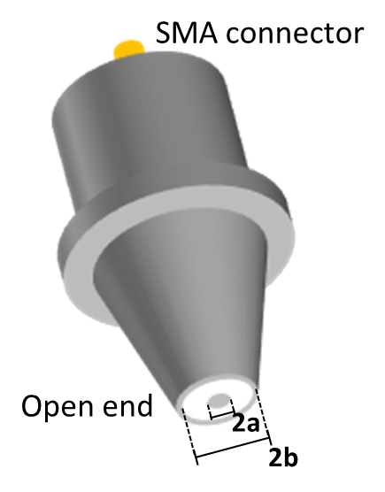
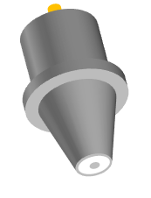
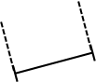

SMA connector
Open end
2a
2b

Slide 2
10 cm
10 cm

Slide 3
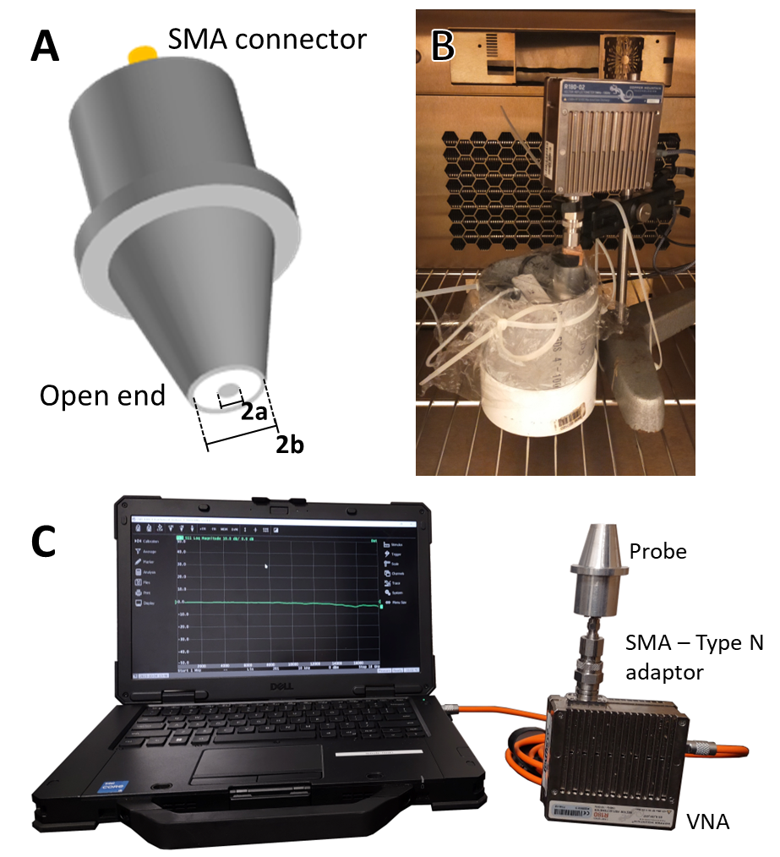

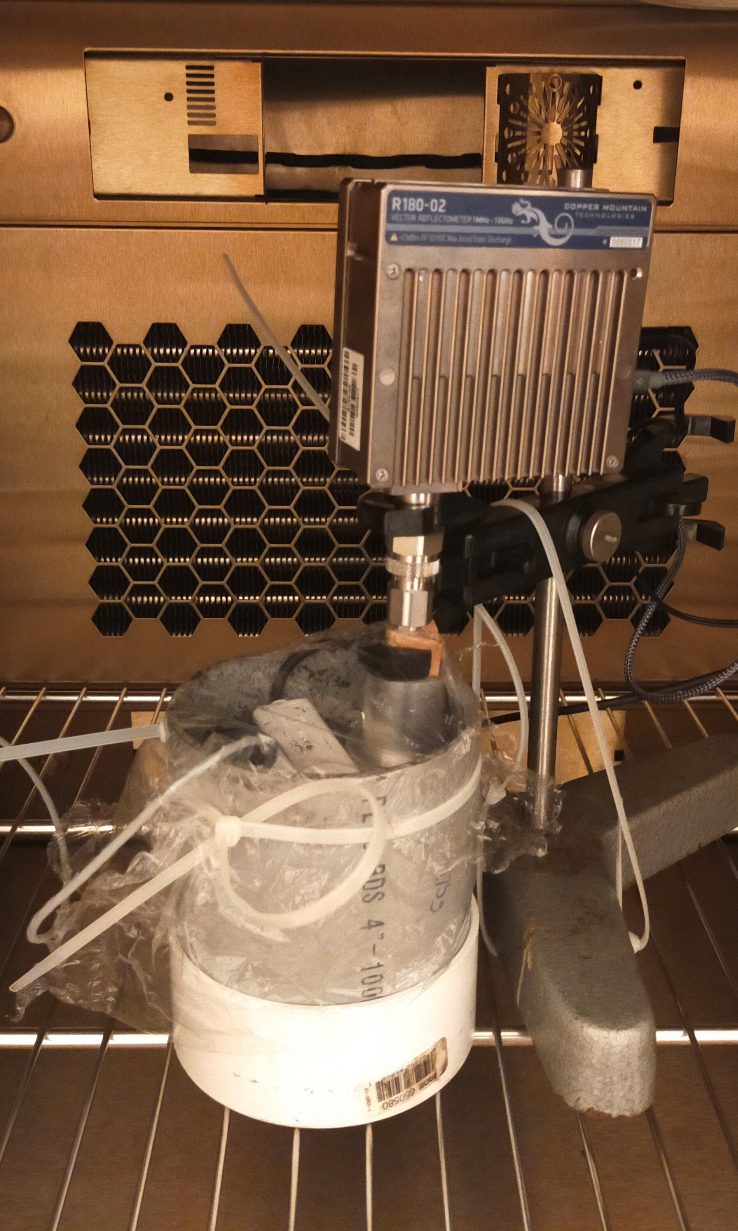
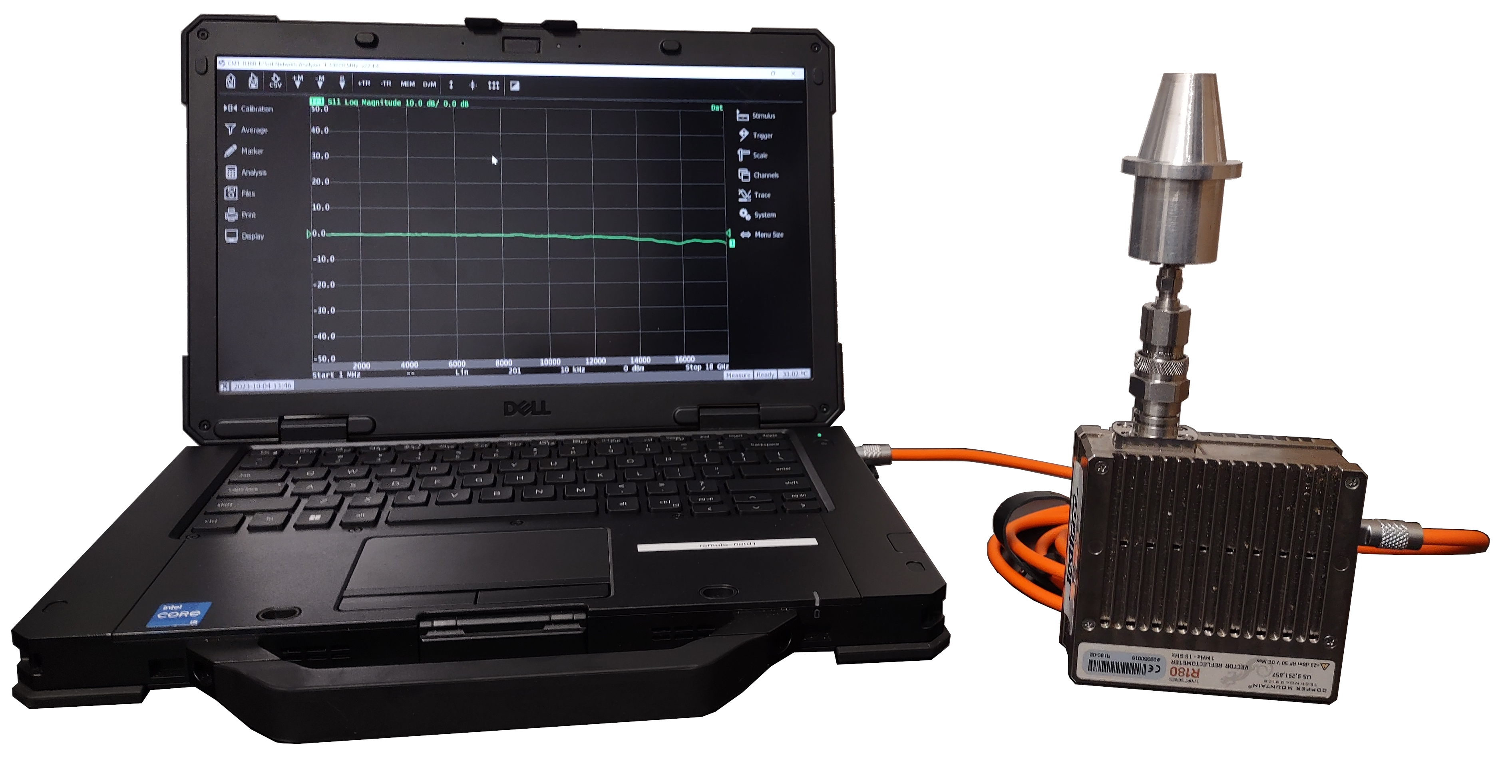
A
B
VNA
Probe
Teros 12
Sample
C
Probe
SMA – Type N
adaptor
VNA

Slide 4
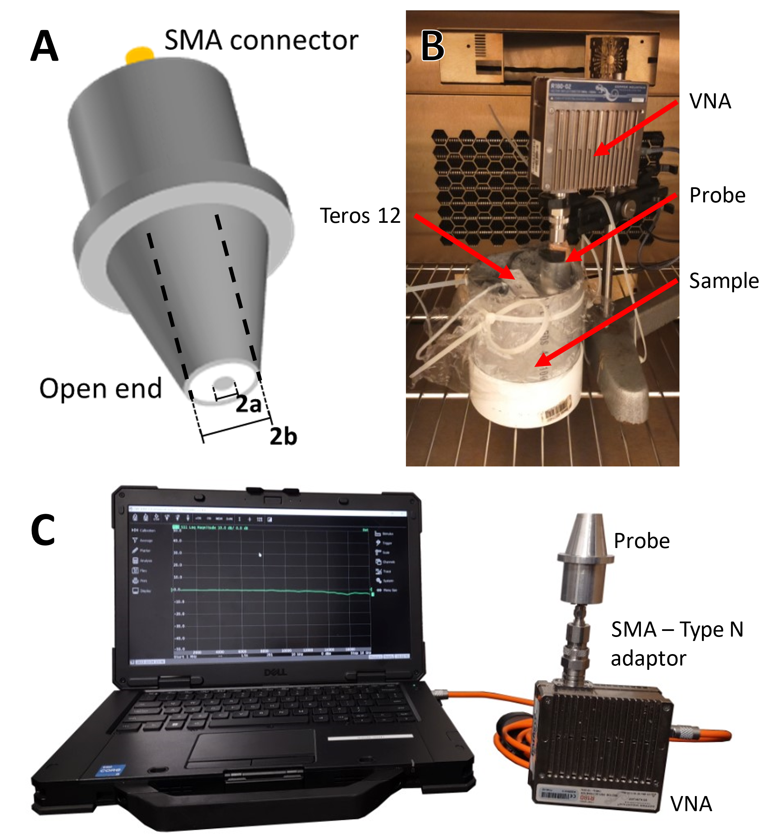
A
B
VNA
Probe
Teros 12
Sample
C
Probe
SMA – Type N
adaptor
VNA

